Slide 1


EXPLORATORY DATA ANALYSIS: MICROSOFT MOVIE STUDIO
By: Trevor Odhiambo

Slide 2

OVERVIEW
Problem: Microsoft is launching a new movie studio and needs data-driven insights on top-performing film types to guide strategic decisions on what genres and formats to produce for box office success.
Goal: Extract meaningful insights to support strategic decisions for Microsoft's movie studio.
Key Questions:
What genres are most produced and perform best at box office?
What are the common IMDb rating patterns?
How long do most movies run?
What characteristics correlate with success?

Slide 3
DATA UNDERSTANDING
Dataset Summary: 2010–2019 (2,952 Films)
• Dataset covers 2,952 films from 2010 to 2019. • Median Runtime: 105 minutes (most films ~1h45min). • IMDb Rating: Median 6.6 (range: 1.6 – 9.2). • User Votes: Median 13,878 (range: 5 – 1.8 million). • Domestic Gross: Median $2M, with outliers up to $700M. • Genres: 317 unique; most frequent is Drama. • Studios: 215 total; Universal produced the most films. • Insight: Success is skewed—top-performing films are rare, so genre and format choices are critical.
2M $
13,878
Median Gross
Median votes
2,952
215
Films
Studios
6.6
105
Median IMDb Rating
Median Runtime (Minutes)

Slide 4
DATA PREPARATION:
Datasets Used:
Tools Used
Python
Google Colab
GitHub
imdb.title.basics.csv – movie metadata (title, genres, year, runtime)
imdb.title.ratings.csv – IMDb ratings and vote counts
bom.movie_gross.csv – box office data (studio, gross revenue)
Data Cleaning
Exploratory Data Analysis
Filtered only movies (removed TV, short films)
Dropped null or incomplete entries (missing gross or rating)
Converted gross fields to numeric
Merged datasets on tconst (IMDB ID) and title
Explored relationships between genre, rating, runtime, vote count, and box office gross. Key visualizations include:
Distribution of IMDb Ratings
Domestic Gross vs IMDb Rating
Most Common Genres
Highest-Grossing Genres
Runtime vs Rating
Correlation Matrix
Top Studios by Average Gross

Slide 5
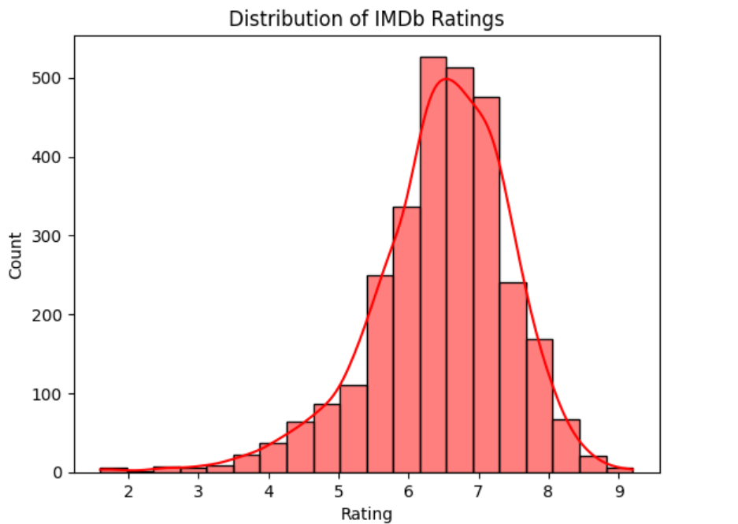
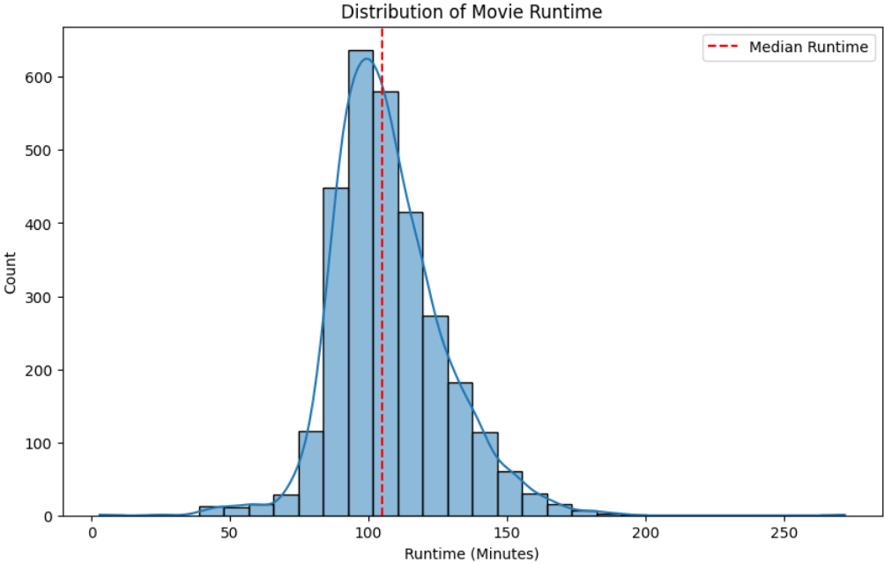
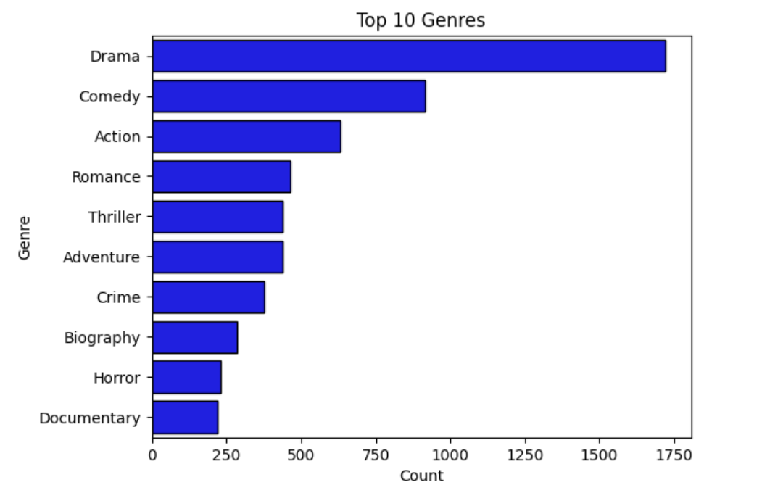
Key Visualizations & Findings
Distribution of Movie Runtime
Distribution of IMDb Ratings
Top 10 Genres
The median runtime is just over 100 minutes.
Most films are clustered between 90–120 minutes
Most movies score between 6 and 7 on IMDb, showing a central tendency toward average to above-average quality.
Very few films score below 4 or above 8.
Drama is the most frequent genre by far, followed by Comedy and Action.
This suggests a heavy industry tilt toward emotionally-driven and entertaining films

Slide 6
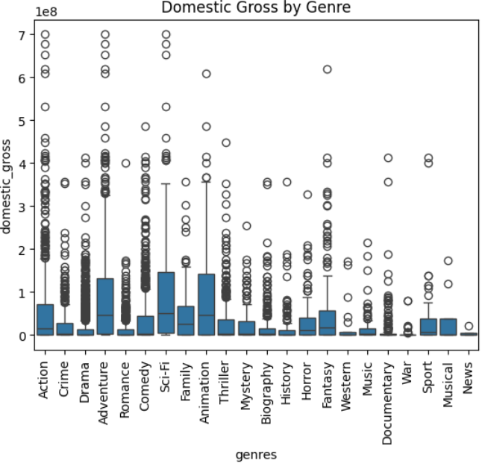
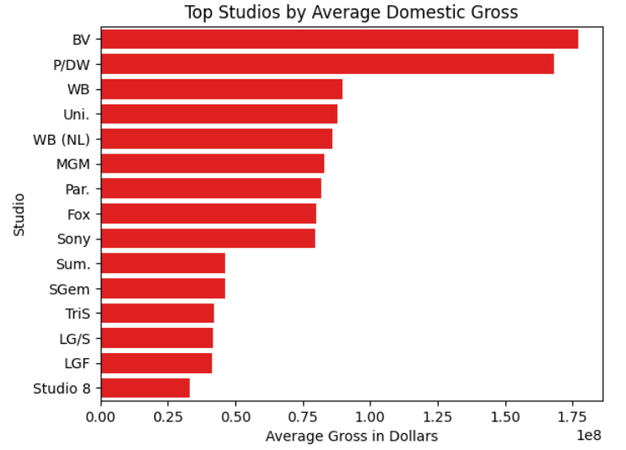
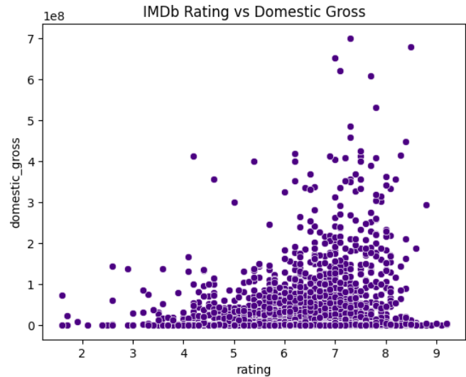
Key Visualizations & Findings
Domestic Gross by Genre
Top Studios by Average Gross
Rating Vs Domestic Gross
SciFi, Adventure, Animation, and Action movies in these genres tend to perform better financially
Sci-Fi, Action, and Adventure have the most number, with films grossing over $500 million and even some approaching $700 million
Buena Vista and Paramount/DreamWorks have a distinct advantage in average box office performance
No direct cause-and-effect relationship between a movie's rating and its domestic gross

Slide 7




Recommendations
Invest in Action and Adventure for high-grossing potential
Aim to build or partner with trusted production houses for quality control
Target runtimes around 90–120 minutes to maintain audience engagement

